Slide 1
Solar cycle variability of atmospheric waves and tides as observed by SuperDARN
Elsayed R. Talaat
Johns Hopkins University Applied Physics Laboratory
J. Michael Ruohoniemi, Raymond G. Greenwald
Virginia Polytechnic and State University
elsayed.talaat@jhuapl.edu

Slide 2
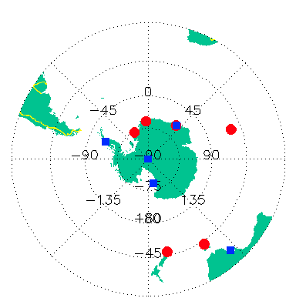
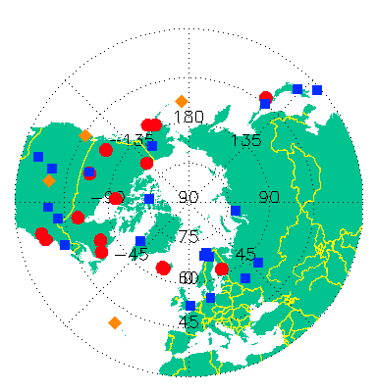
SuperDARN HF Radars

Slide 3
SuperDARN–insights into mesopause activity
Mesopause dynamics dominated by waves
Cause of day-to-day, seasonal, and interannual variability
Drivers of the mean structure of the mesosphere and lower thermosphere
SuperDARN meteor wind analysis:
Daily specification of tides and planetary waves
De-aliasing of tidal modes
Non-linear interaction between planetary waves and tides
Long-term analysis of inter-annual and solar cycle variations
73-day oscillation, QBO, solar cycle, SSW
Six NH radars with >10 years of near continuous data are used:
Kapuskasing, Saskatoon, Goose Bay, Hankasalmi, Stokkseyri, Pykkvibaer

Slide 4
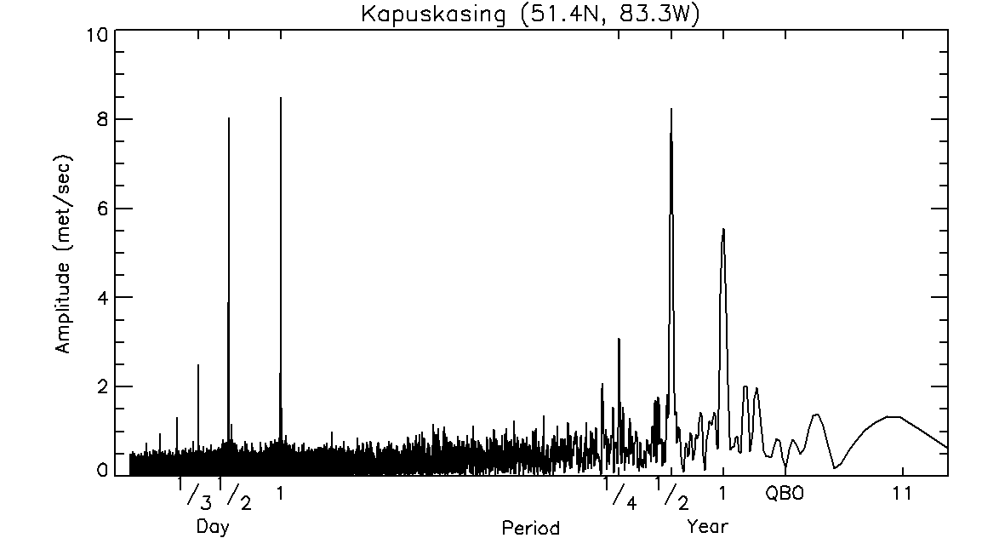
Periodicities in the meridional wind
diurnal > semidiurnal
semiannual > annual

Slide 5
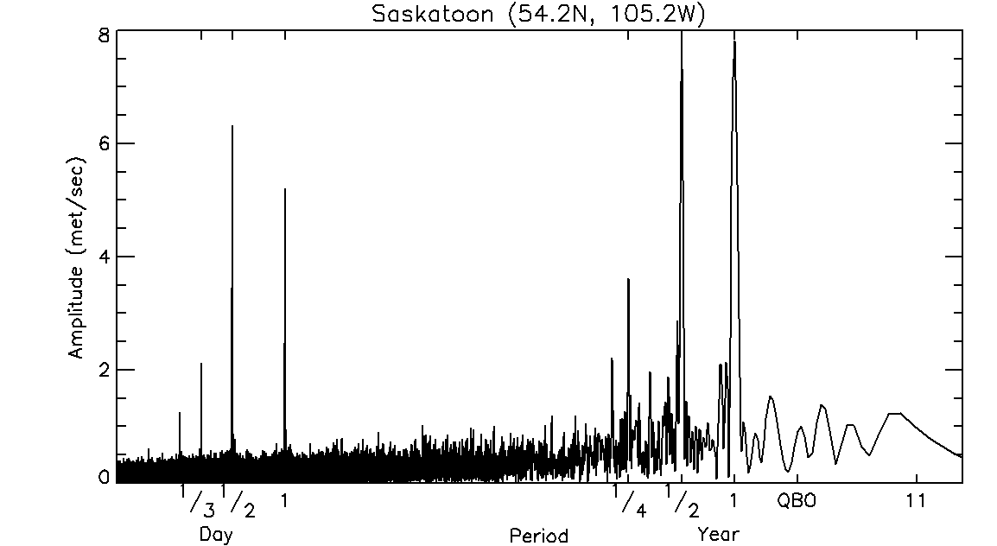
Periodicities in the meridional wind
diurnal < semidiurnal
semiannual > annual

Slide 6
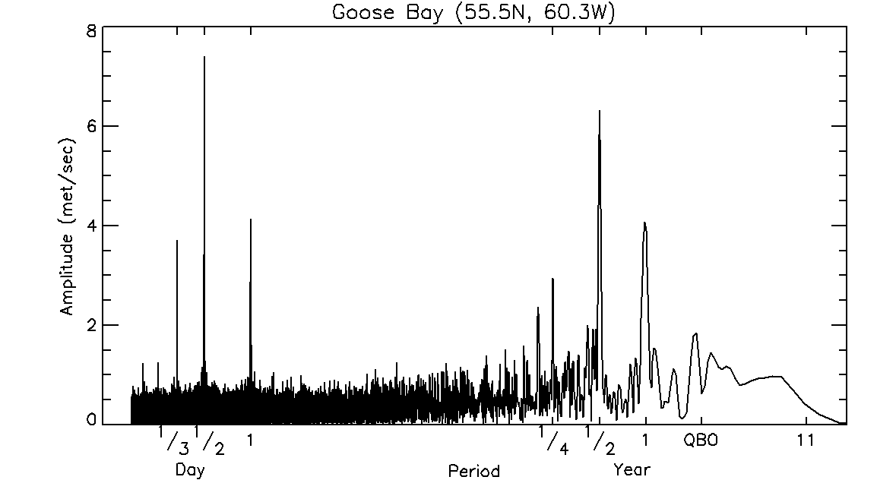
Periodicities in the meridional wind
diurnal < semidiurnal
semiannual > annual

Slide 7
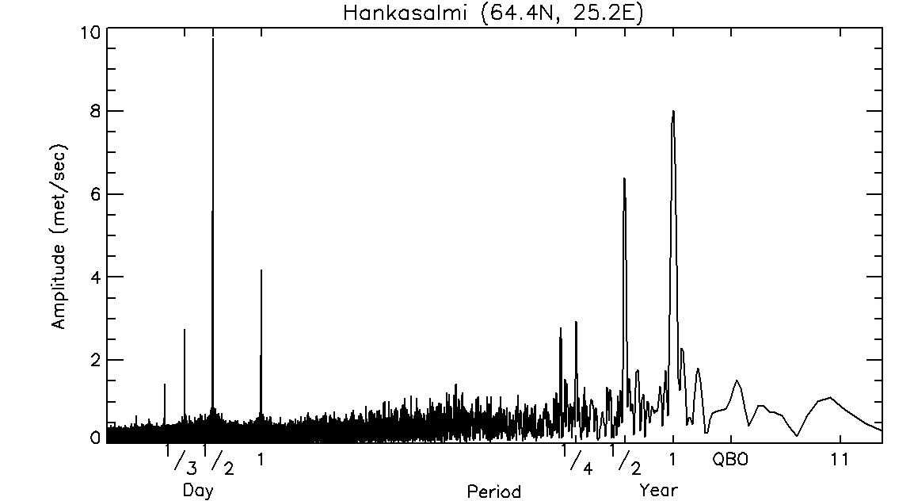
Periodicities in the meridional wind
diurnal << semidiurnal
semiannual < annual

Slide 8
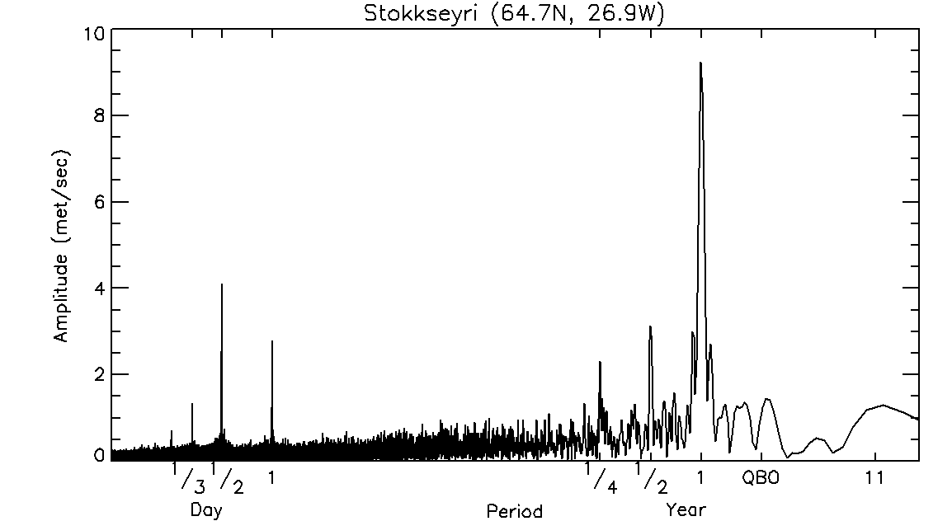
Periodicities in the meridional wind
diurnal < semidiurnal
semiannual << annual

Slide 9
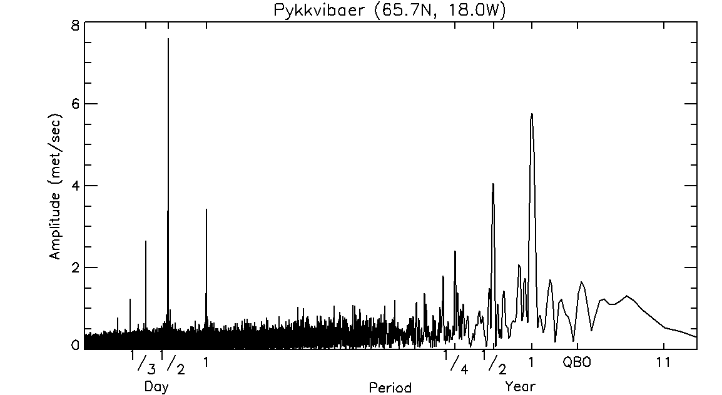
Periodicities in the meridional wind
diurnal << semidiurnal
semiannual < annual

Slide 10
Forcing of Thermal Tides
Extreme & Far Ultraviolet
O
Solar Cycle
Altitude (km)
Thermosphere
Schumann-Runge
Bands & Continuum
SAO
O₂
~90 km
Mesosphere
Ultraviolet
QBO
O₃
~30 km
Stratosphere
Infrared
H₂O
Troposphere
~15 km
Latent Heat
Sensible Heat
Temperature

Slide 11
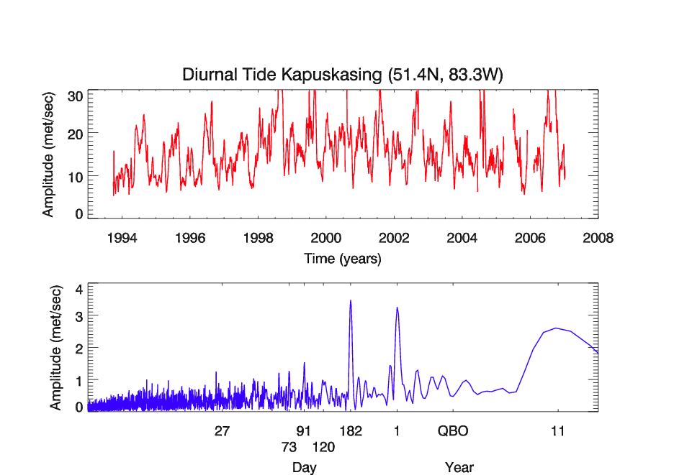
Variability at middle latitudes

Slide 12
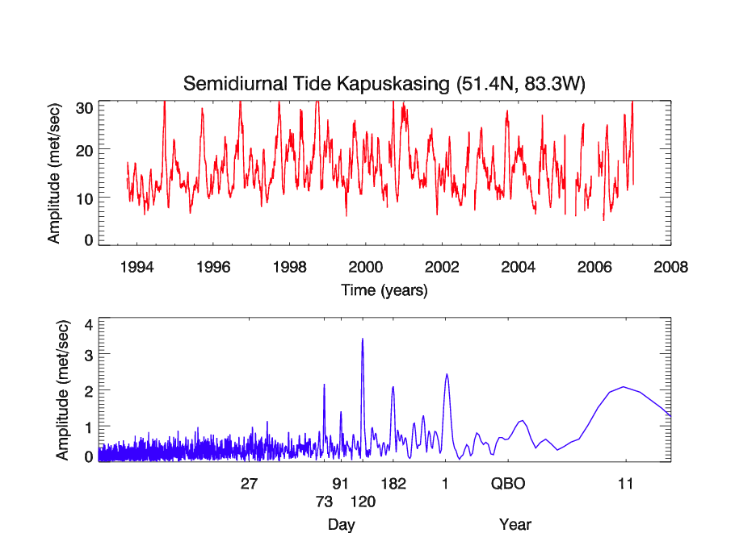
Variability at middle latitudes

Slide 13
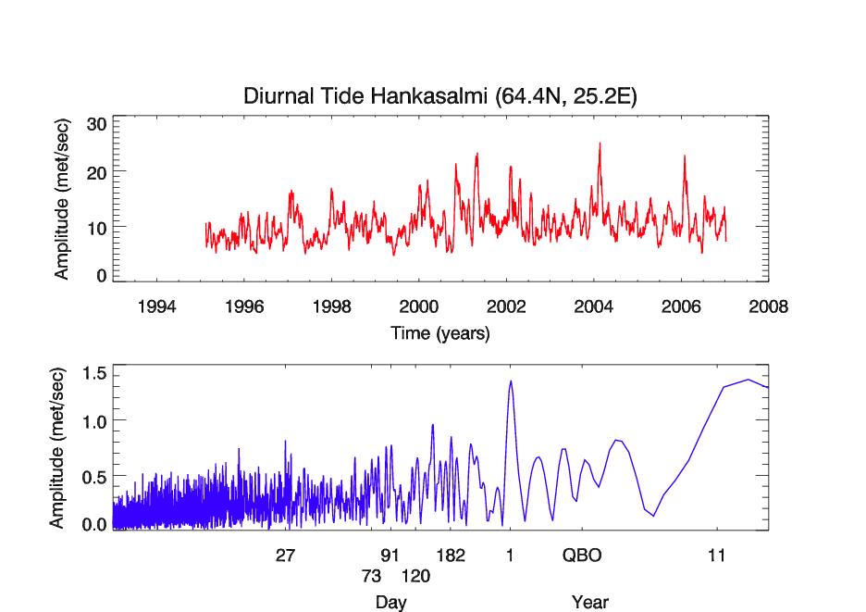
Variability at high latitudes

Slide 14
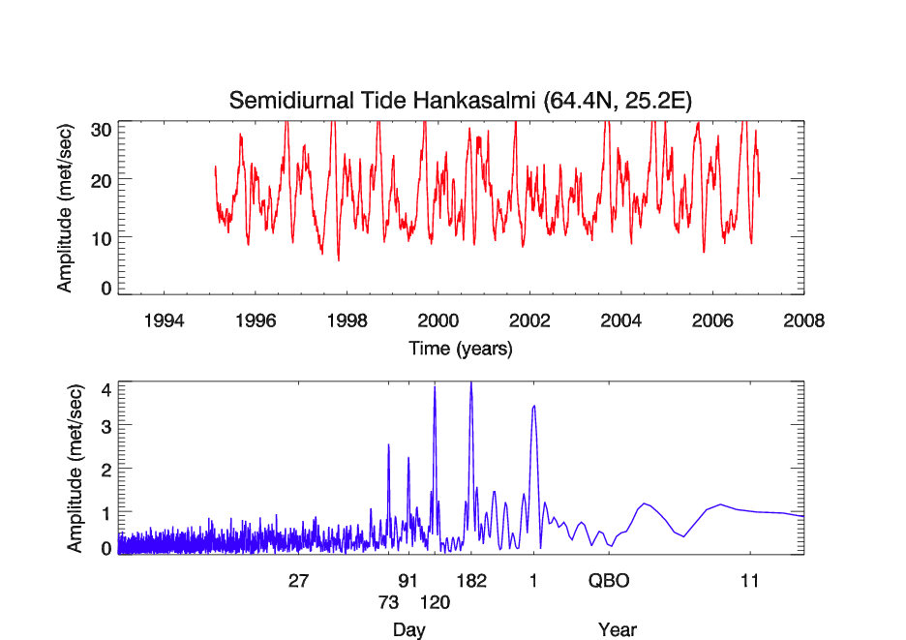
Variability at high latitudes

Slide 15
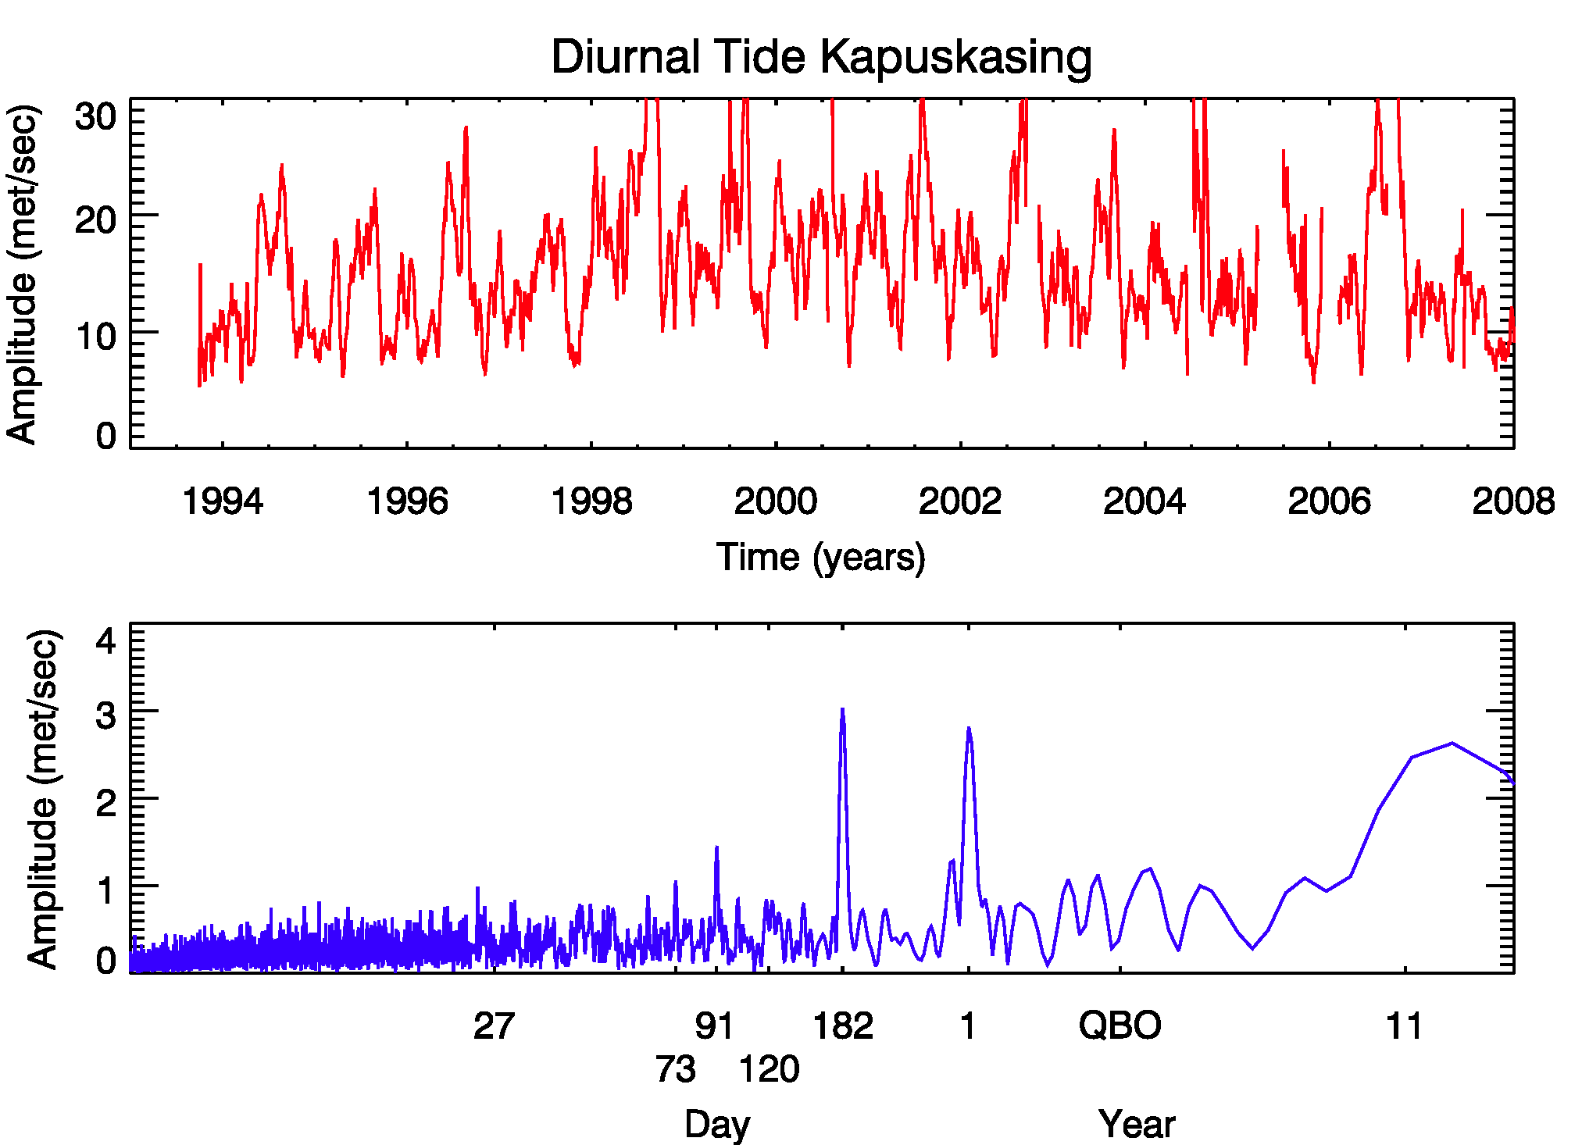
Solar Cycle Prominent

Slide 16
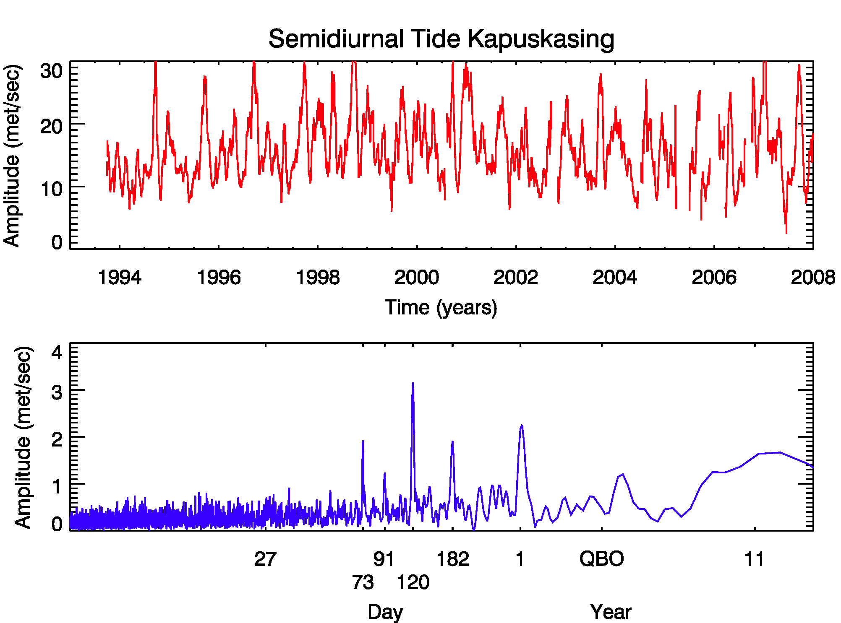
73-day oscillation present

Slide 17
Average Wave Power

Slide 24
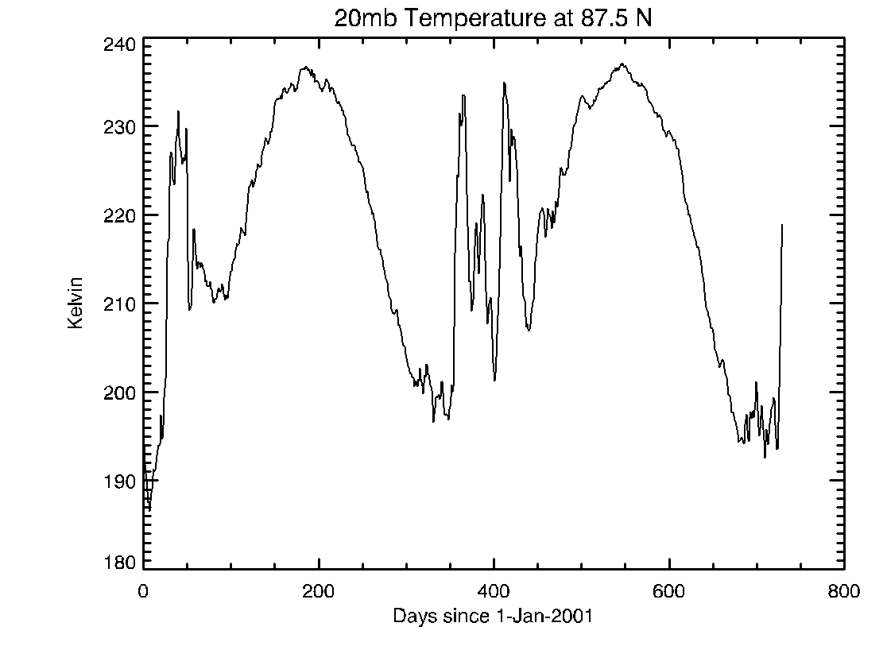
Sudden Stratospheric Warmings

Slide 25
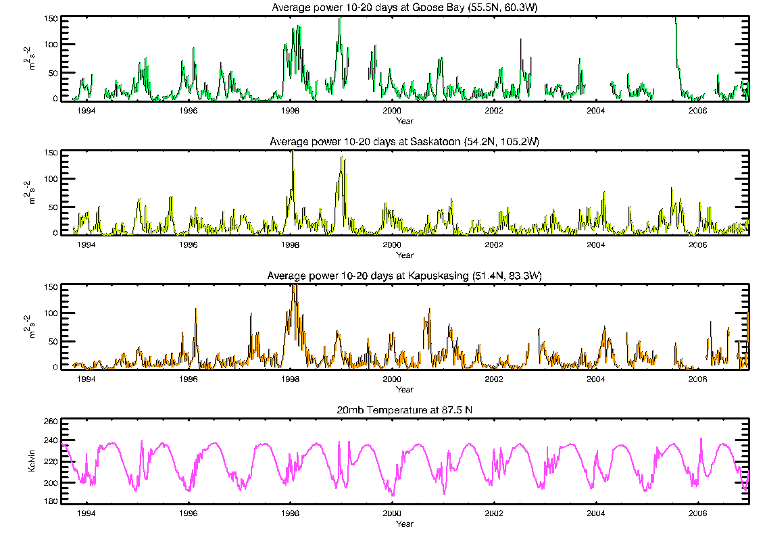

Slide 26
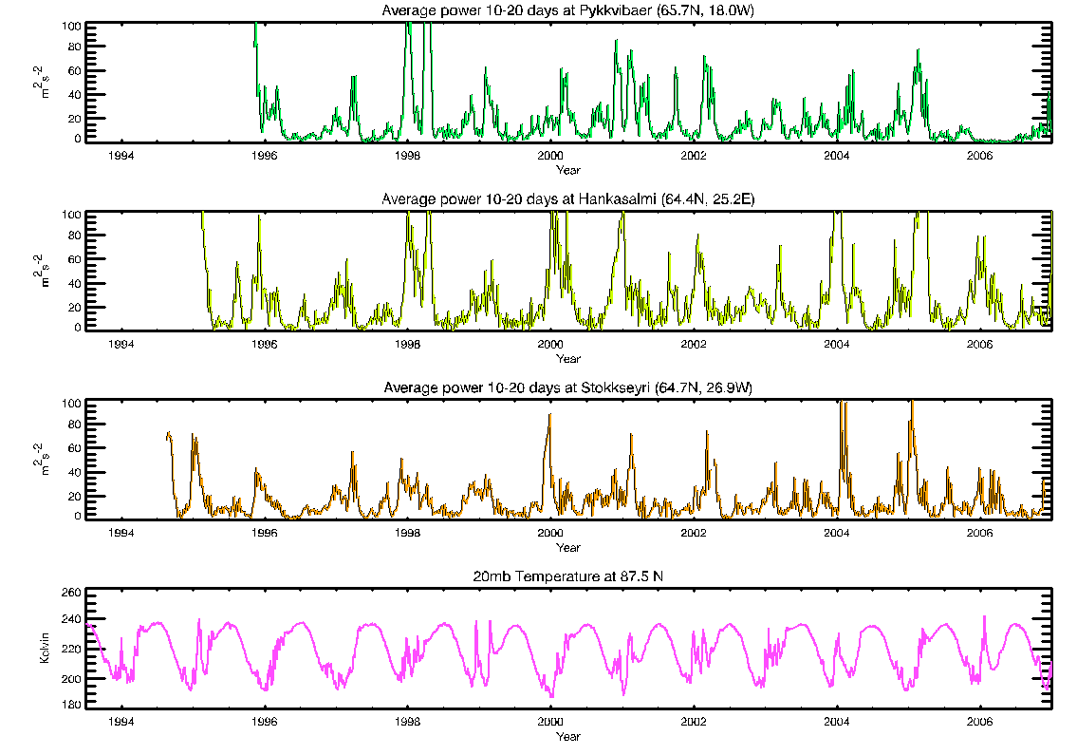

Slide 27
Summary
At mid- and high-latitudes, a persistent 73-day oscillation observed in the meteor winds. Also seen as a variability in semidiurnal tidal amplitudes. Semiannual variation is larger than annual at low- latitudes; vice versa at high-latitudes.
Semidiurnal tide becomes the dominant tide at mid- and high-latitudes.
Both diurnal and semidiurnal tide show evidence of solar cycle variability. Not much variation at QBO frequency in the meteor winds.
Planetary wave activity peaks at ~2, 5, 8, 10, 15, 25 days
QBO signatures associated with sudden stratospheric warming.
Significant variability in the long-term analysis of planetary waves at different radars. Solar cycle variability peaks at Kapuskasing and Saskatoon.

Slide 28
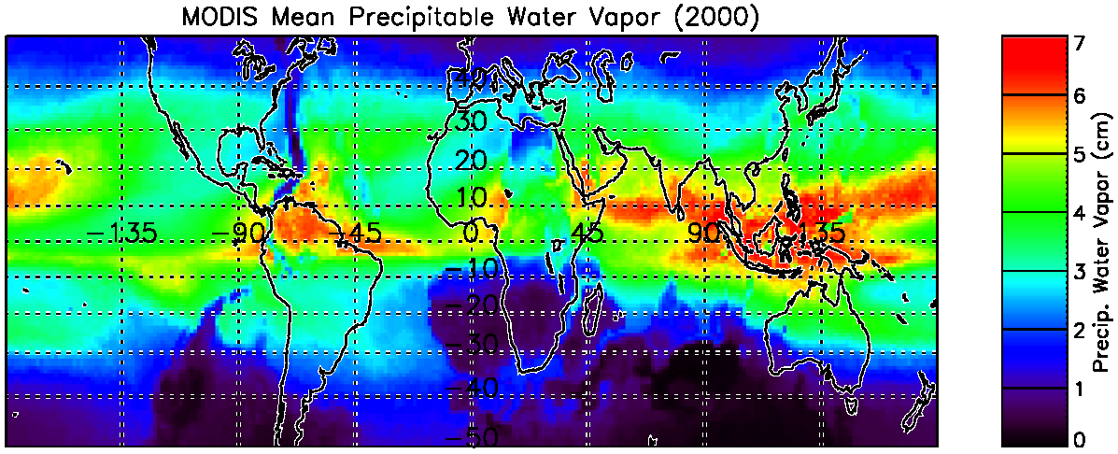
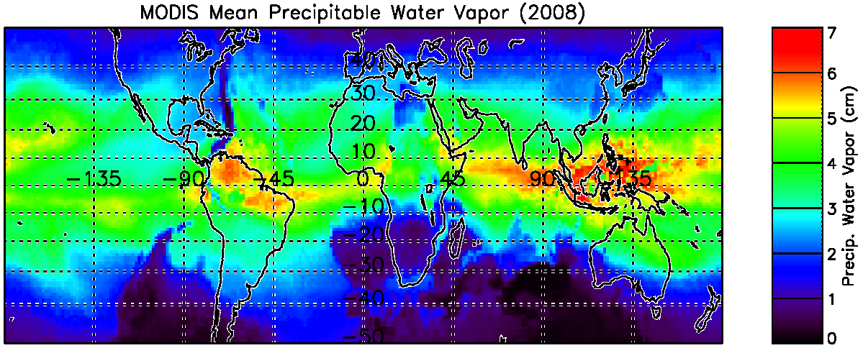
Open Questions…
Why 73 days (and not 120, etc.)? Geomagnetic effect?
Go to the source - examination of lower atmosphere water vapor from MODIS on Aqua and Terra and ozone from TIMED

Slide 29
Tides from TIMED/SABER
The migrating (W1) (top) and eastward s=3 diurnal (DE3) (middle) amplitude extracted from TIMED/SABER temperatures (v1.07) at the equator at 90 km and 110 km, respectively. The suppressed amplitudes during 2003, 2005, and 2007 correspond to the westward (blue) phase of the QBO (bottom). Contours are 10 m/sec. Several other tidal modes are of secondary importance.

Slide 30
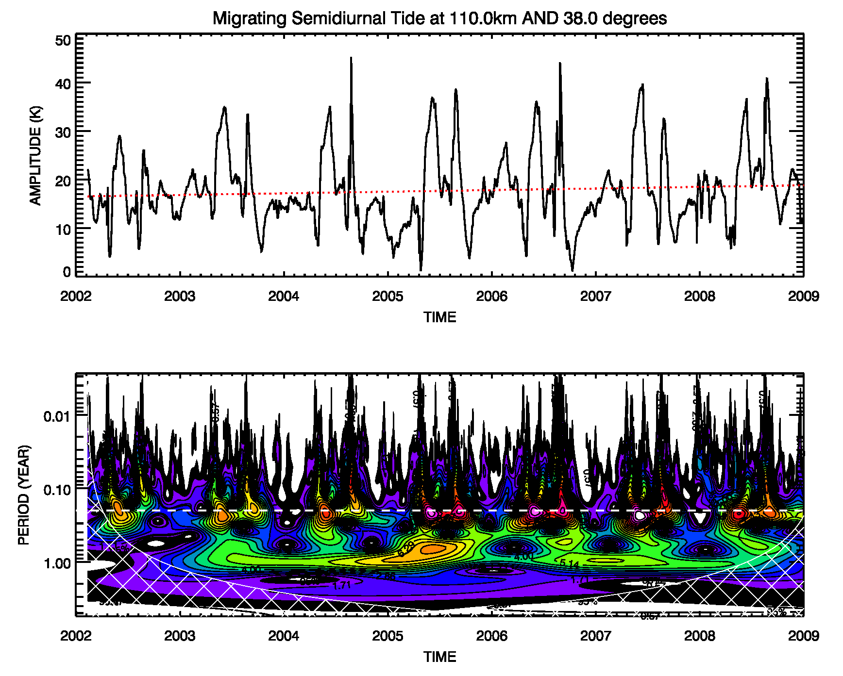
73-day oscillation

Slide 31
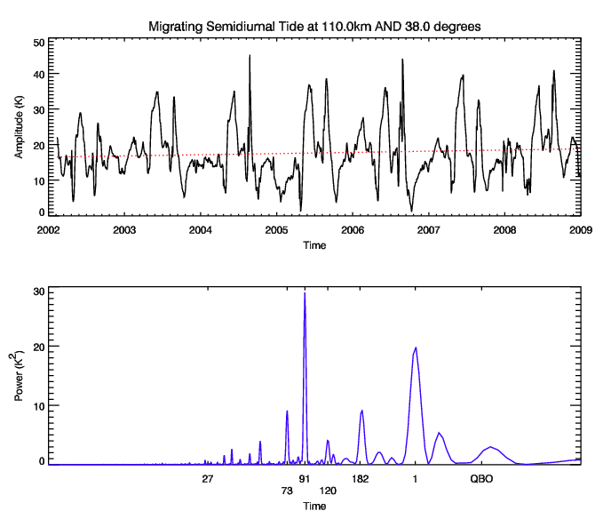
73-day oscillation

Slide 32
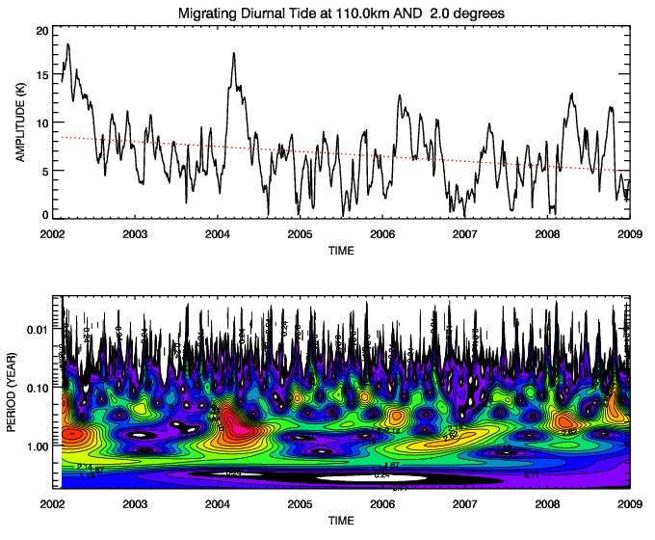
Solar cycle variation?

Slide 33
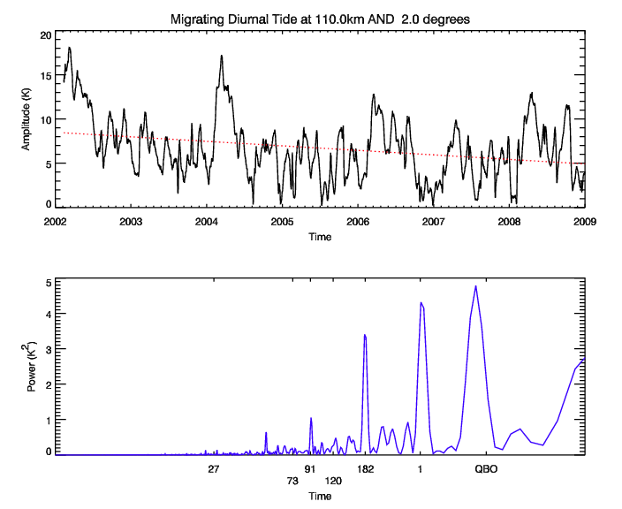
Solar cycle variation?

Slide 34
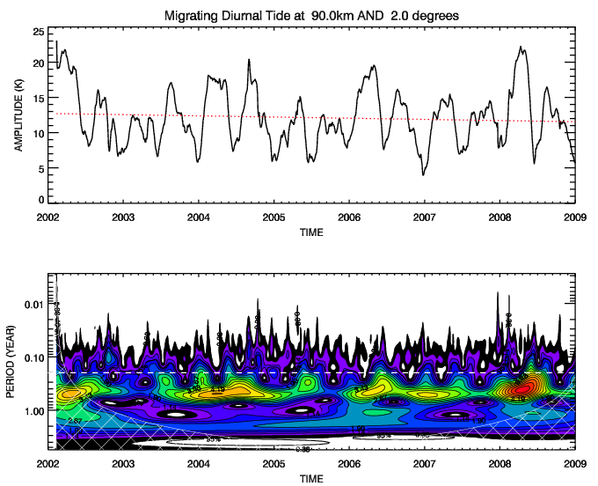
Solar cycle variation?

Slide 35
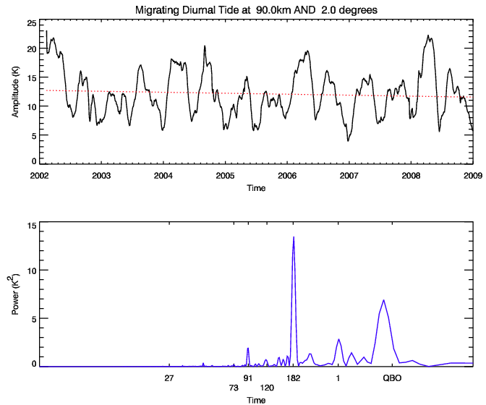
Solar cycle variation?

Slide 36
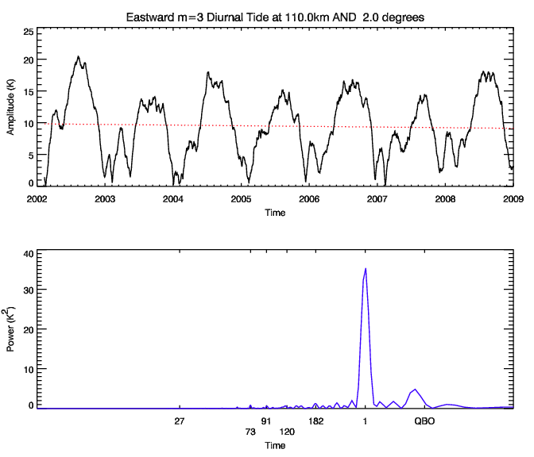
Solar cycle variation?

Slide 37
Acknowledgements
The authors are grateful from for support from NSF CEDAR Award 0640864 and the NSF Cooperative Agreement ATM-0418101.

Slide 38
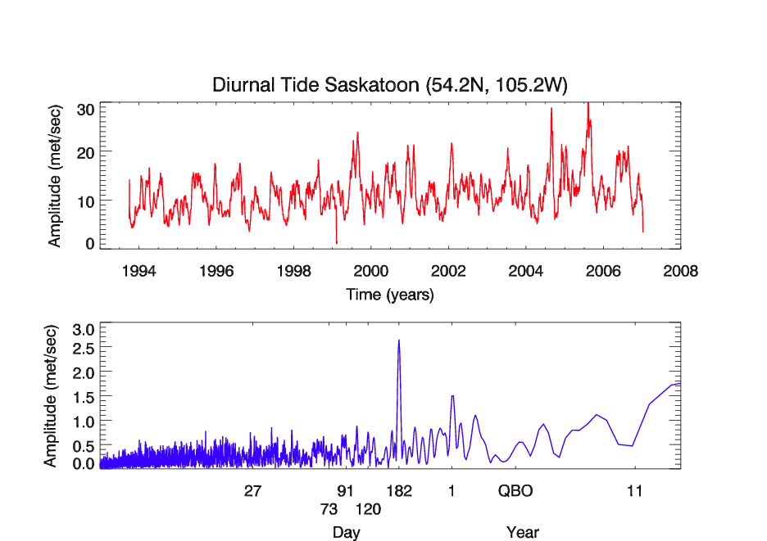
Variability – Saskatoon

Slide 39
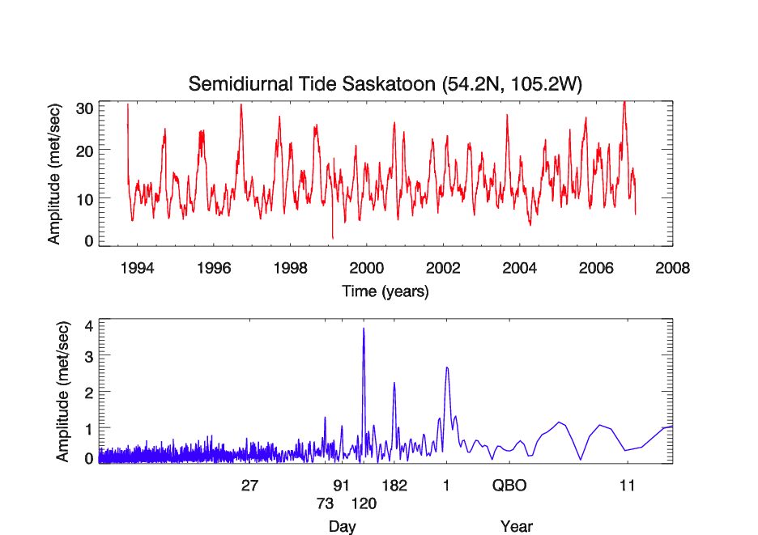
Variability – Saskatoon

Slide 40
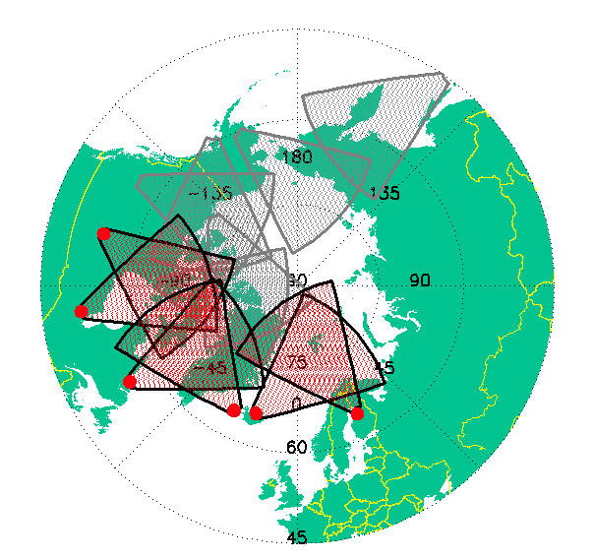
SuperDARN HF Radars Mesospheric neutral wind measurements
Saskatoon
Kapuskasing
Goose Bay
Hankasalmi
Stokkseyri
Pykkvibaer

Slide 41
Stratospheric Warming
Rise in stratospheric temperatures due to the associated breakdown of polar vortex winds
Northern hemisphere has minor warmings every winter and major warmings every ~ 2 years
Southern hemisphere rarely has major warmings
Mesosphere and thermosphere temperature and wind response
Connections to low latitude QBO
Planetary wave amplification and propagation

Slide 42
Sudden Stratospheric Warmings

